Slide 1
Bayesian Belief Network

Slide 2
Bayesian Belief Network
Bayesian Belief Network in artificial intelligence
Bayesian belief network is key computer technology for dealing with probabilistic events and to solve a problem which has uncertainty. We can define a Bayesian network as:
"A Bayesian network is a probabilistic graphical model which represents a set of variables and their conditional dependencies using a directed acyclic graph."
It is also called a Bayes network, belief network, decision network, or Bayesian model.
Bayesian networks are probabilistic, because these networks are built from a probability distribution, and also use probability theory for prediction and anomaly detection.

Slide 3
Bayesian Belief Network
Real world applications are probabilistic in nature, and to represent the relationship between multiple events, we need a Bayesian network. It can also be used in various tasks including prediction, anomaly detection, diagnostics, automated insight, reasoning, time series prediction, and decision making under uncertainty.
Bayesian Network can be used for building models from data and experts opinions, and it consists of two parts:
Directed Acyclic Graph
Table of conditional probabilities.

Slide 4
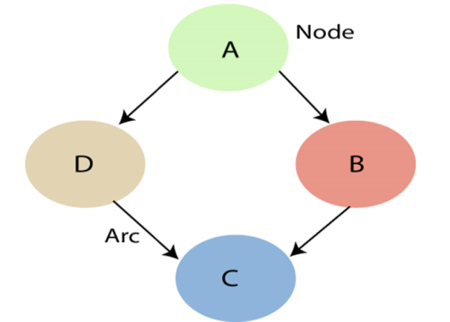
Bayesian Belief Network
A Bayesian network graph is made up of nodes and Arcs (directed links), where:
Each node corresponds to the random variables, and a variable can be continuous or discrete.
Arc or directed arrows represent the causal relationship or conditional probabilities between random variables. These directed links or arrows connect the pair of nodes in the graph.
These links represent that one node directly influence the other node, and if there is no directed link that means that nodes are independent with each other
In the below diagram, A, B, C, and D are random variables represented by the nodes of the network graph.
If we are considering node B, which is connected with node A by a directed arrow, then node A is called the parent of Node B.
Node C is independent of node A.

Slide 5
Bayesian Belief Network
Note: The Bayesian network graph does not contain any cyclic graph. Hence, it is known as a directed acyclic graph or DAG.
A directed graph G with four vertices A,B,C, and D. If p(xA,xB,xC,xD) factorizes with respect to G, then we must have p(xA,xB,xC,xD) = p(xA)p(xB|xA)p(xC|xB)p(xD|xC).
A
B
C
D

Slide 6
Bayesian Belief Network
Bayesian network is based on Joint probability distribution and conditional probability. So let's first understand the joint probability distribution:
Joint probability distribution:
If we have variables x1, x2, x3,....., xn, then the probabilities of a different combination of x1, x2, x3.. xn, are known as Joint probability distribution.
P[x₁, x₂, x₃,....., x_{n}], it can be written as the following way in terms of the joint probability distribution.
= P[x₁| x₂, x₃,....., x_{n}]P[x₂, x₃,....., x_{n}]
= P[x₁| x₂, x₃,....., x_{n}]P[x₂|x₃,....., x_{n}]....P[x_{n-1}|x_{n}]P[x_{n}].
In general for each variable Xi, we can write the equation as:
P(X_{i}|X_{i-1},........., X₁) = P(X_{i} |Parents(X_{i} ))

Slide 7
Explanation Bayesian Belief Network
Bayesian Network can be used for building models from data and experts opinions, and it consists of two parts:
Directed Acyclic Graph
Table of conditional probabilities.

Slide 8
Explanation Bayesian Belief Network
Directed Acyclic Graph: is the pictorial representation of the events that occurred.
Node: Hypothesis
Edge: conditional probability
Note: # node has at least two probabilities.
# Probabilities are calculated on the
Basis of parent.
Conditional Probability Table
B=T & R=T=0.19
B=T & R=F=0.375
B=F & R=T=0.66
B=F & R=F=0.375
Rain
Dog_Bark|Rain
 | R | ~R
B | 9/48 | 18/48
~B | 3/48 | 18/48
Rain
Cat|Hide|Dog_Bark
Rain

Slide 9
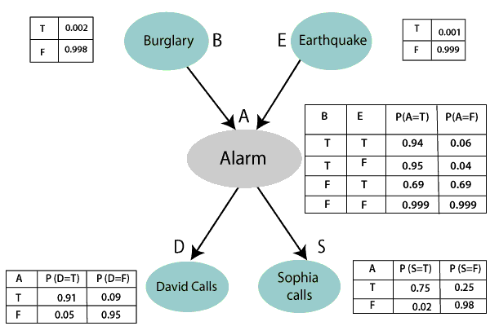
Bayesian Belief Network
Solved Example: Calculate the probability that alarm has sounded, but there is neither a burglary, nor an earthquake occurred, and David and Sophia both called the Harry.

Slide 10
Bayesian Belief Network
P(S, D, A, ¬B, ¬E) = P (S|A) *P (D|A)*P (A|¬B ^ ¬E) *P (¬B) *P (¬E).
= 0.75* 0.91* 0.001* 0.998*0.999
= 0.00068045.

